Slide 1
Basic cmd based operating system.
Presented by:
Tahzib Mahmud Rifat (2001005)
Md. Numanur Rahman (2001011)
Md Jalish Mahamud (2001014)
Sajid Allam (2001019)

Slide 2

Contents
Introduction
Environment setup
Available command
File management System
Memory Management
Process Scheduling
Inter Process Communication
Conclusion

Slide 3
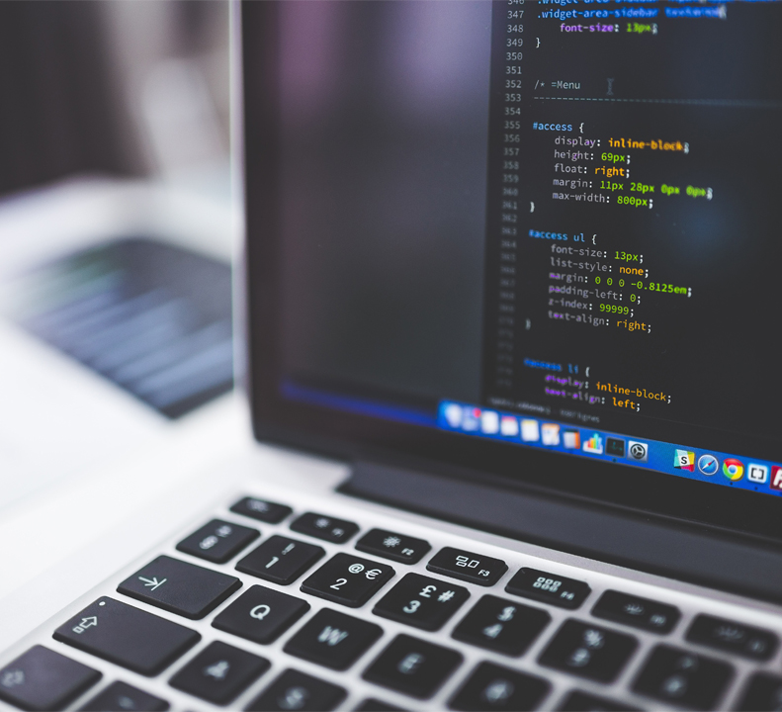
Introduction
Basic cmd based file management system.
Takes various types of command and give respective outputs.
Specially compatible with file management system, Process Scheduling, Memory Management & Inter Process Communication

Slide 4

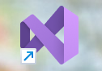


Environmental Setup
For our OS development we set up our environment in the following way:
Installed visual studio
Installed .NET framework
Installed CosMos OS development kit
Installed VMWare

Slide 5
Available command
echo : To print anything.
date : To print the current date.
time : To print the current time.
ls : To print all the file or directory.
shutdown : To close the OS.
cd : To change the directory.
File Management System
CPU/Process scheduling : cpuscd
Memory management : mem
Inter Process communication: ipc

Slide 6


File Management System
createfile
writefile
readfile
appendfile
updatefile
deletefile
createdir
deletedir

Slide 7
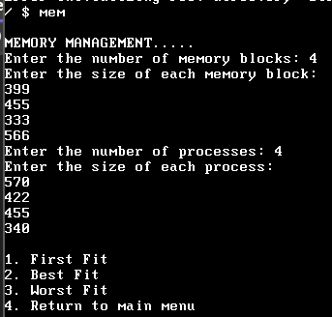
Memory Management
To perform memory management the command is ‘mem’.
It will take the number of memory blocks with size first. And then it will take the number of processes with size.
The allocation we used:
First fit
Best fit
Worst fit

Slide 8
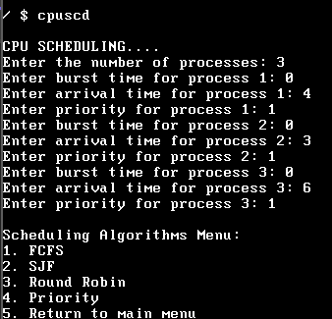
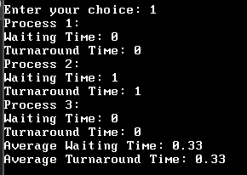
Process Scheduling
To perform CPU scheduling the command is ‘cpuscd’.
It will take the number of processes with burst time, arrival time and priority.
The scheduling algorithms are:
FCFS
SJF
Round Robin
Priority

Slide 9
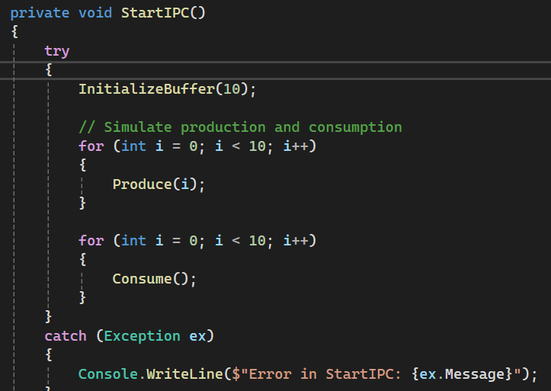
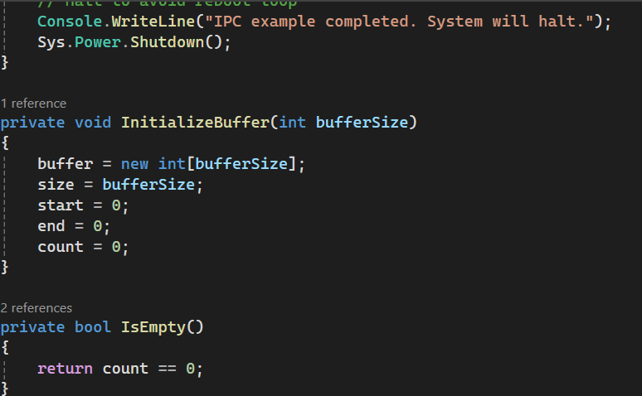
Inter Process Communication
To perform inter process communication we used: ‘ipc’ command.

Slide 10

Conclusion
‘Basic cmd based OS’ aims to provide a hands-on learning experience for developers interested in operating system development. Through the implementation of basic command features, users will gain insights into the core principles of operating systems while having a functional environment for day-to-day tasks.

Slide 11


